Slide 1
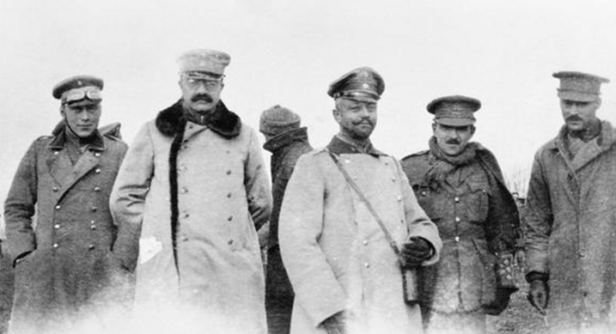
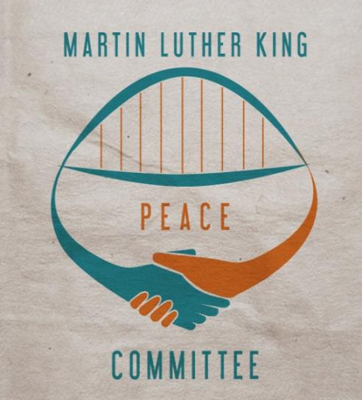
THE DECEMBER 1914 CHRISTMAS TRUCES
Produced by the Northumbria and Newcastle Universities Martin Luther King Peace Committee
Notes:
This slideshow is designed to be used in conjunction with the junior church/Sunday School plan in the ‘Silent Night, Holy Truce’ resource pack for church leaders, available for free download at www.mlkpc.org
This picture shows British and German officers fraternising in ‘no man’s land,’ Christmas 1914. Photographer: H.B. Robson, Northumberland Hussars.
The notes in these text boxes are intended for use in an assembly: the church leaders pack contains notes to explain the slides in a Sunday School activity.

Slide 2
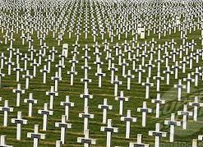

Slide 3
“There is neither Jew nor Gentile, neither slave nor free, nor is there male and female, for you are all one in Christ Jesus.”
Galatians chapter 3 verse 28
Notes:
This important verse in the Bible teaches us that to belong to the family of Jesus Christ is more important than belonging to a country.

Slide 4
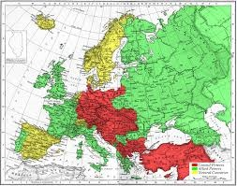
Notes:
This is a map of Europe in 1914. Different countries were grouped together in alliances. On one side were France, Britain and Russia. This alliance is coloured green. On the other side were Germany, Austria and Turkey. This alliance is coloured red. When the war began, these 2 big alliances of countries were fighting against each other. Not many countries were neutral – that means they were not part of either side (these are coloured yellow). In greater depth: In June 1914 Archduke Franz Ferdinand of Austria was assassinated by Serbian nationalist Guy Princip. Austria declared war on Serbia, and pre-established alliances set the war in motion as Russia mobilised its army against Austria, and in response to that Germany mobilised against Russia. France responded by declaring war on Germany, which invaded Belgium as the shortest route to attack Paris. Britain, which had a treaty with Belgium, declared war on Germany. Later in the war other countries joined, for example Turkey on the side of Germany and Austria, and Italy and the USA on the other side.

Slide 5
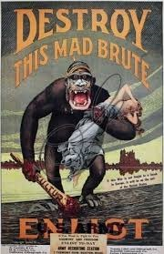
Notes:
This is a propaganda poster. There were lots of posters designed to get young men to sign up and enrol in the armed forces. All the different countries in the war had these posters.

Slide 6
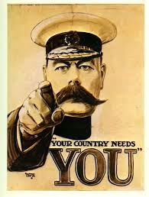
Notes:
This is probably the most famous British World War One recruitment poster of all.

Slide 7
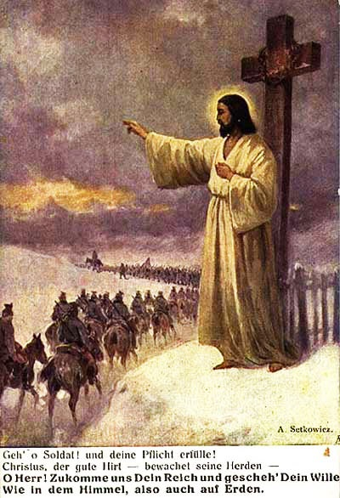
Notes:
The birth of Jesus Christ is celebrated as the coming of the ‘Prince of Peace,’ yet his image was used by politicians and armies to recruit soldiers to fight. Here is just one example – this one is from Germany.
Translation: “Go on soldier! And fulfill your duty! Christ, the good shepherd watches over his flock. Our Father in heaven, hallowed be your name, Your kingdom come, your will be done, on earth as in heaven.”

Slide 8
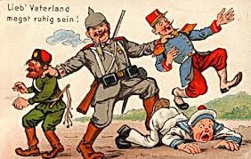
Notes:
This is a German propagandea poster. Germany is represented giving a good bashing to naughty Russia, France and (sprawling on the ground) Britain.
In greater depth: The translation of the message is ‘Dear Fatherland – you can sleep easy’ (ie sure that the combined threats of enemy states will be dealt with).

Slide 9
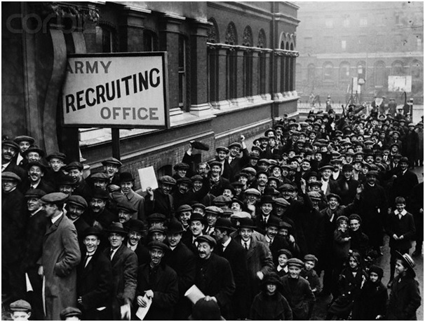
Notes:
Many people in all the countries greeted the outbreak of war with enthusiasm. They thought their own country was right. Some thought that war would be an adventure. They believed that their side would win – and probably very quickly, without many people having to die. It was said that “it will all be over by Christmas”. The British men signing up at the Army Recruitment office in this picture believed that Germany was the enemy and that they should fight Germany and its allies.
In greater depth: In Britain, that helpless little Belgium was invaded by its giant neighbour made many people angry, especially after reports – some of which were untrue – of German atrocities were widely circulated. In Germany, there was great enthusiasm for finally taking a stand against the world-dominating British Empire. A common Biblical analogy drawn by German leaders was that their country was like plucky David fighting (in the British) the evil Philistine giant Goliath.

Slide 10
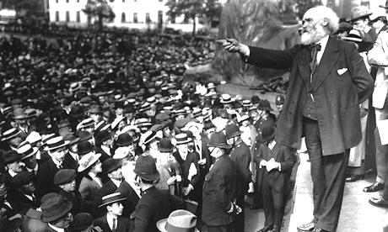
Notes:
Thousands of people gathered in Trafalgar Square in London on August 2nd to demonstrate for peace and against the war. Here we see Keir Hardie, a member of parliament, addressing the crowd.

Slide 11
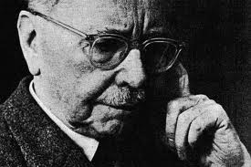
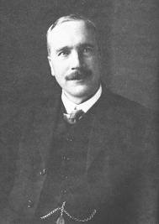
Friedrich Siegmund-Schultze (above)
Henry Hodgkin (right)
Fellowship of Reconciliation
Notes:
Friedrich Siegmund-Schultze (of Germany) and Henry Hodgkin (of Britain) were at a meeting of Christian leaders in 1914. They said ‘we are one in Christ and can never be at war.’ They founded the Fellowship of Reconciliation which called on its members to refuse to join in the war. Many Christians were arrested and put in prison for this stand against the war.

Slide 12
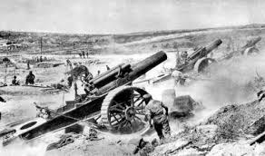
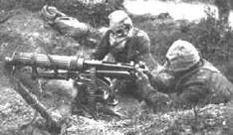
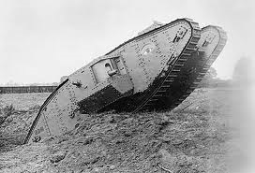
Notes:
World War One was marked by new types of weapons including tanks, airships, and powerful artillery and machine guns.

Slide 13
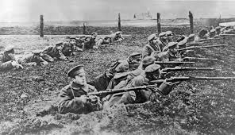
Trench warfare
Notes:
Both sides made ‘trenches’ – networks of ditches, holes and tunnels dug in the ground and supported by sand-bags to protect themselves from enemy shots. They were laced with barbed wire and machine-gun emplacements.

Slide 14
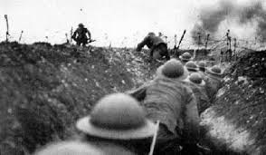
Notes:
The British and German front-line trenches were usually between 50 and 250 metres apart, with the space between them known as ‘no-man’s land.’

Slide 15
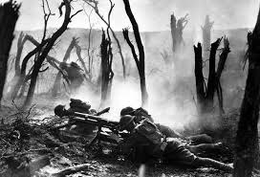
Notes:
When told to attack the enemy trenches, hundreds of men would charge across no-man’s land, running into a ‘storm of steel’ of bullets and artillery shells. Later in the war, poison gas was used. If they reached the enemy and somehow got through the barbed wire, they would fight at close-quarters in the muddy trenches.

Slide 16
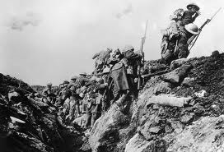
Notes:
Men who went ‘over the top’ were very vulnerable to these new types of weapon. On July 1st 1916, at the start of the Battle of the Somme, nearly 20,000 British soldiers were killed in one day alone.

Slide 17
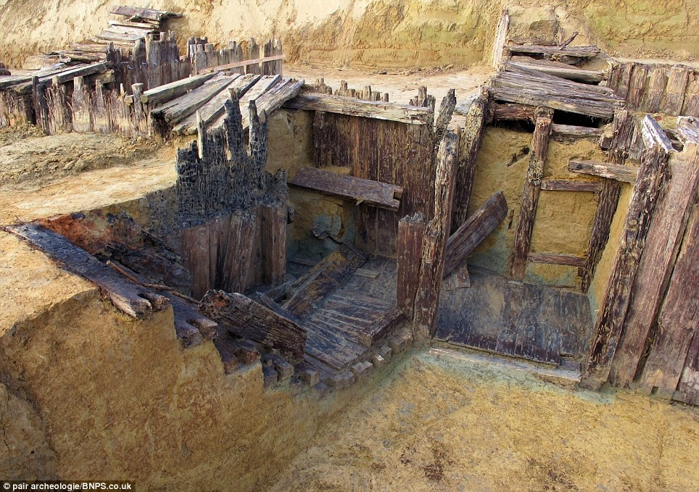
Notes:
Trenches became infested with lice, beetles, diseases, and hordes of rats gorging on dead bodies Trenches often stank of excrement and rotting corpses. Many wounded men were sucked into the deep mud and drowned. This slide shows German trenches excavated in 2012 by archaeologists. The bodies of 21 soldiers were found. They had been buried underground when the tunnel they were sheltering in had collapsed under shelling.

Slide 18
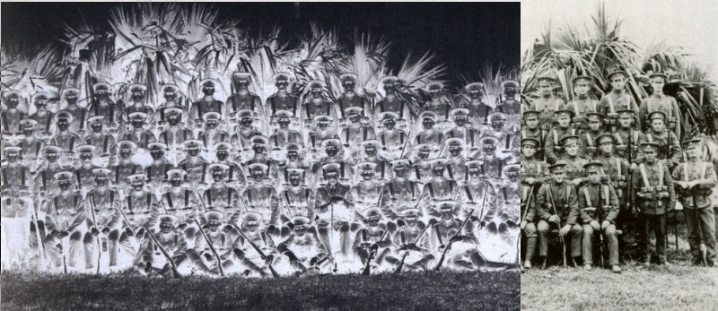
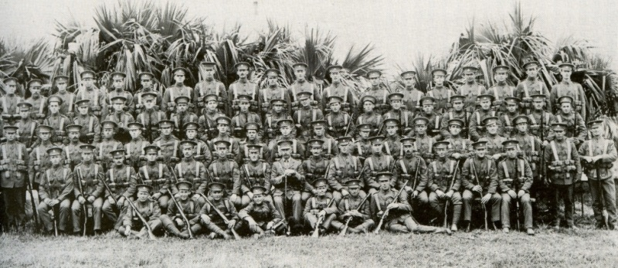
Notes:
When they joined the army, many men believed that the war would be over by the first Christmas. Instead, by then thousands of people had been killed and there was no sign of an end. The war continued until 1918 by which time some 10 million soldiers across all countries had died. More British soldiers were killed in this war than in any other in our history, including World War Two. Sometimes men from the same village, factory, or sports club would join the army together and be allowed to serve together. These so-called ‘pals battalions’ often suffered heavy losses. This slide is a picture of the Bermuda Volunteer Rifles, a British army corps which between 1914 and 1915 lost 75% - three quarters – of its men.

Slide 19
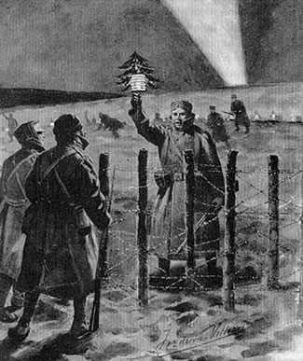
Notes:
The British and German trenches were often so close that enemy soldiers could see each other and hear each other shout messages across. Therefore in some places soldiers had agreed not to fight. But on a frosty Christmas Eve 1914, when soldiers were thinking of family at home, something amazing happened. It is described by a soldier from Gateshead, writing a letter on Christmas Day to a friend in Low Fell:
“Last night the Germans lit up their trenches and started calling across merry Christmas. We responded in the same way and then we started singing songs to one another, carols etc. All shooting had stopped. We walked about the tops of the trenches and called out to one another. Then some of our chaps walked out and met some of the Germans half way, wishing each other a merry Christmas, shook hands and said they would not fight today.”
Artist’s impression London Illustrated News, 9 January 1915.

Slide 20
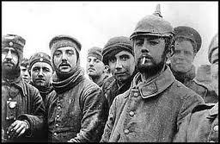
Notes:
British and German soldiers took photographs of each other, showed each other pictures of their families, and promised to stay in touch. A German solider asked a British solider to post a letter to his girlfriend in Manchester, which he later did. The Gateshead soldier wrote:
“One [German soldier] has given me his address to write to him after the war. They were quite a decent lot of fellows I can tell you. I know this seems an unbelievable story but it is fact. I am sure if it was left to the men there would be no war. “

Slide 21
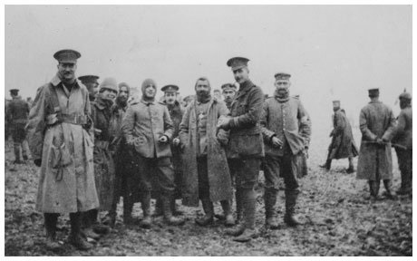
Notes:
Soldiers met, gave each other presents, and shared food and drink. Before the war many Germans had worked in Britain as butchers and hairdressers, and there are accounts of Germans giving British soldiers haircuts in no-man’s land!
In greater depth: “After the 19th December attack, we were back in the same trenches when Christmas Day came along. It was a terrible winter, everything was covered in snow, everything was white. The devastated landscape looked terrible in its true colours -clay and mud and broken brick- but when it was covered in snow it was beautiful. Then we heard the Germans singing 'Silent night, Holy night', and they put up a notice saying 'Merry Christmas', and so we put one up too.
While they were singing our boys said, 'Let's join in,' so we joined in and when we started singing, they stopped. And when we stopped, they started again. So we were easing the way. Then one German took a chance and jumped up on top of the trench and shouted out, 'Happy Christmas, Tommy!' So of course our boys said, 'If he can do it, we can do it,' and we all jumped up. A sergeant-major shouted 'Get down!' But we said, 'Shut up Sergeant, it's Christmas time!' And we all went forward to the barbed wire.
We could barely reach through the wire, because the barbed wire was not just one fence, it was two or three fences together, with a wire in between. And so we just shook hands and I had the experience of talking to one German who said to me, 'Do you know where the Essex Road in London is?' I replied, 'Yes, my uncles had a shoe repairing shop there.' He said, 'That's funny. There's a barber shop on the other side where I used to work.'
They could all speak very good English because before the war, Britain was invaded by Germans. Every pork butcher was German, every barber's shop was German, and they were all over here getting the low-down on the country. It's ironic when you think about it, that he must have shaved my uncle at times and yet my bullet might have found him and his bullet might have found me.
Private Frank Sumter, London Rifle Brigade.”

Slide 22
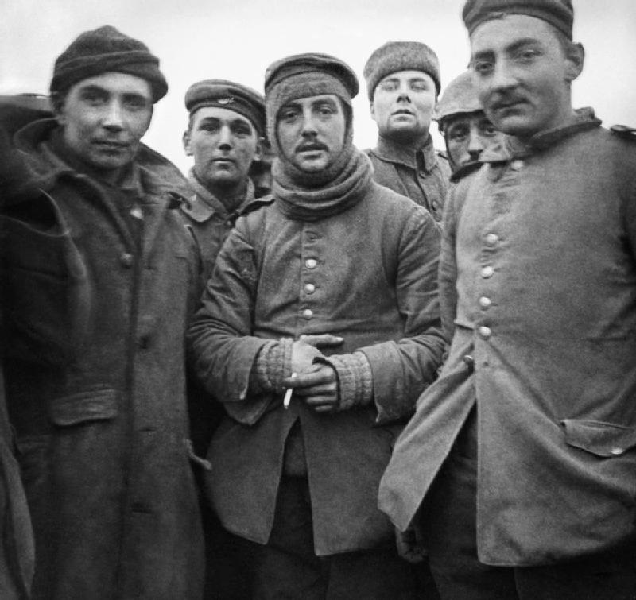

Slide 23
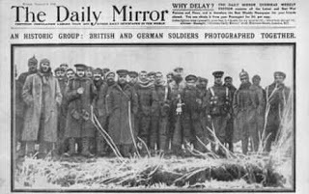
Notes:
Over the previous months no-man’s land had become scattered with the decaying corpses that it was unsafe to recover. Men used the truces to bury their friends, and also to mark Christmas as a joint religious festival with prayers, carols and Bible readings in both languages.
In greater depth: 19 year-old Arthur Pelham-Burn, a lieutenant in the 6th Gordons who was planning to study to become a church minister after the war, took part in a joint service on Christmas Eve, and wrote home that:
The mass burial of the dead was ‘awful, too awful to describe so I won’t attempt it,’ but the joint burial service was ‘most wonderful. Chaplain Adams arranged the prayers and the twenty-third psalm etc and an interpreter wrote them out in German. They were read first by our Padre and then in German by a boy who was studying for the ministry. It was an extraordinary and most wonderful sight. The Germans formed up on one side, the English on the other, the officers standing in front, every head bared. Yes, I think it was a sight one will never see again.

Slide 24
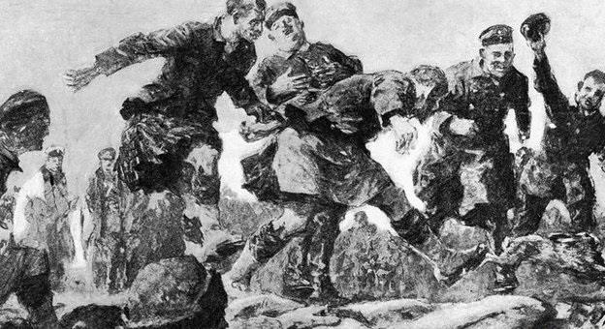
Notes:
Some letters written home by British and German soldiers claim that games of football were played in no-man’s land.
In greater depth: Thus Company-Sergeant Major Frank Naden wrote that after making friends:
“The Scotsmen started the bagpipes and we had a rare old jollification, which included football in which the Germans took part. The Germans expressed themselves as being tired of the war and wished it was over.”

Slide 25
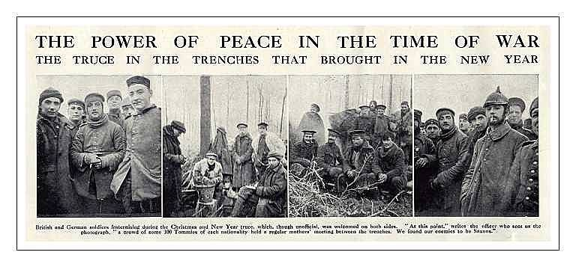
Notes:
The heads of the British and German armies were angry that their men had stopped fighting and ordered them to start again. Many soldiers on both sides were reluctant to fight again. In some cases they pretended to fight, shooting at the ‘enemy’ when officers came to inspect them but missing on purpose or warning them in advance to keep down. Some soldiers who didn’t obey orders were punished and new soldiers sent to the trenches to fight.
In greater depth: Frank Naden wrote:
“Next day we got an order that all communication and friendliness with the enemy must stop but we did not fire at all that day, and the Germans did not fire at us."
Sergeant George Ashurst, 2nd Battalion, Lancashire Fusiliers, wrote:
Eventually, we got orders to come back down into the trench, 'Get back in your trenches, every man!' The order came round by word of mouth down each trench. Some people took no damn notice.
Anyway, the generals behind must have seen it and got a bit suspicious, so they gave orders for a battery of guns behind us to open fire and a machine -gun to open out, and officers to fire their revolvers at the Jerries. That started the war again. We were cursing the generals to hell. You want to get up here in this mud. Never mind you giving orders in your big chateaux and driving about in your big cars. We hated the sight of bloody generals, we always did. We didn't hate them so much before this, but we never liked them after that.
Then we had newspapers coming here from England accusing us of fraternising with the Germans: parsons accusing us of fraternising with the Germans when there had been an armistice on Christmas Day. I wrote back home and told my family off. I said we could do with that parson and the fellows that are writing in the newspapers here, I said. We want them here in front of us instead of Jerry so we could shoot them down for passing remarks like that while nice and safe in England.
A soldier from Jarrow wrote a letter on Boxing Day about stopping fighting to celebrate Christmas with the Germans, but finished by adding:
“Now today it is different. Where we were at peace with them yesterday, we are at war today and the guns are roaring as usual and the rifles are being fired. It is a queer time right enough!”
It was certainly strange to be fighting again: and the armies continued fighting until 1918, by which time around 10 million soldiers had died. High command sought to prevent future similar fraternisation by soldiers in future Christmases by issuing orders expressly forbidding it, and order attacks instead. Lance-Corporal George Dyce, who participated in the truces, said of the Germans,
‘They don’t want to fight any more than we do; they are as fed up of this game as we are fit to be. They told us that they would not shoot if we did not, so we have had a holiday for the last two days we were in the trenches… I thought peace was proclaimed, but no such luck.’

Slide 26
“There is neither Jew nor Gentile, neither slave nor free, nor is there male and female, for you are all one in Christ Jesus.”
Galatians chapter 3 verse 28

